Slide 1

Critical thinking through Lesson Plan revision:
How to use revision to combat an overreliance on AI and promote the use Of HQIM Materials

Slide 2

HAVE A GO
FIRST:
Create free ChatGPT account and log in if you don’t have one already
THEN:
Ask ChatGPT to create a lesson plan on fluency.

Slide 3
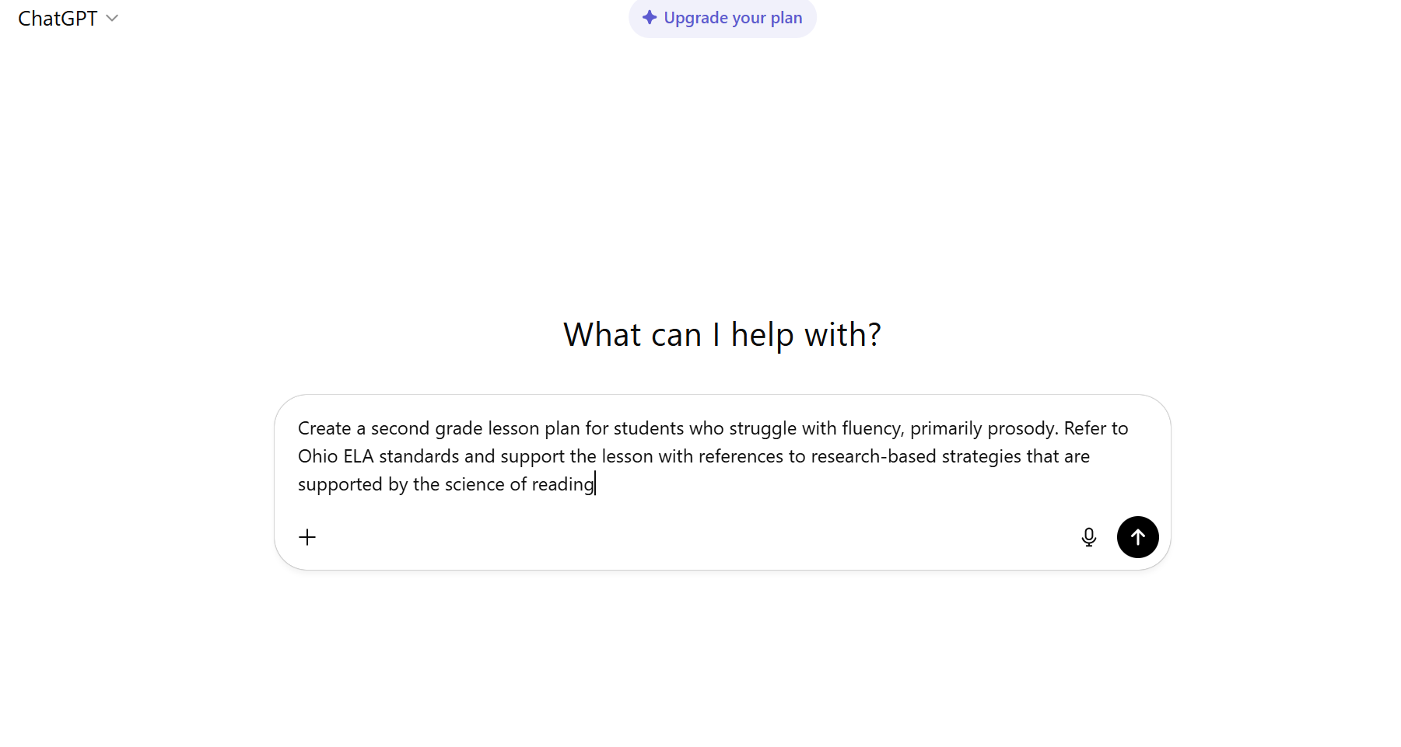
Now, use chat GPT to create a lesson plan That you assign to your students
NEXT:
Try adding a few different parameters, but note how you changed the terms
For example:
For second graders
For students who struggle with reading aloud
For Tier 2 intervention
FINALLY:
Be prepared to share your results

Slide 4
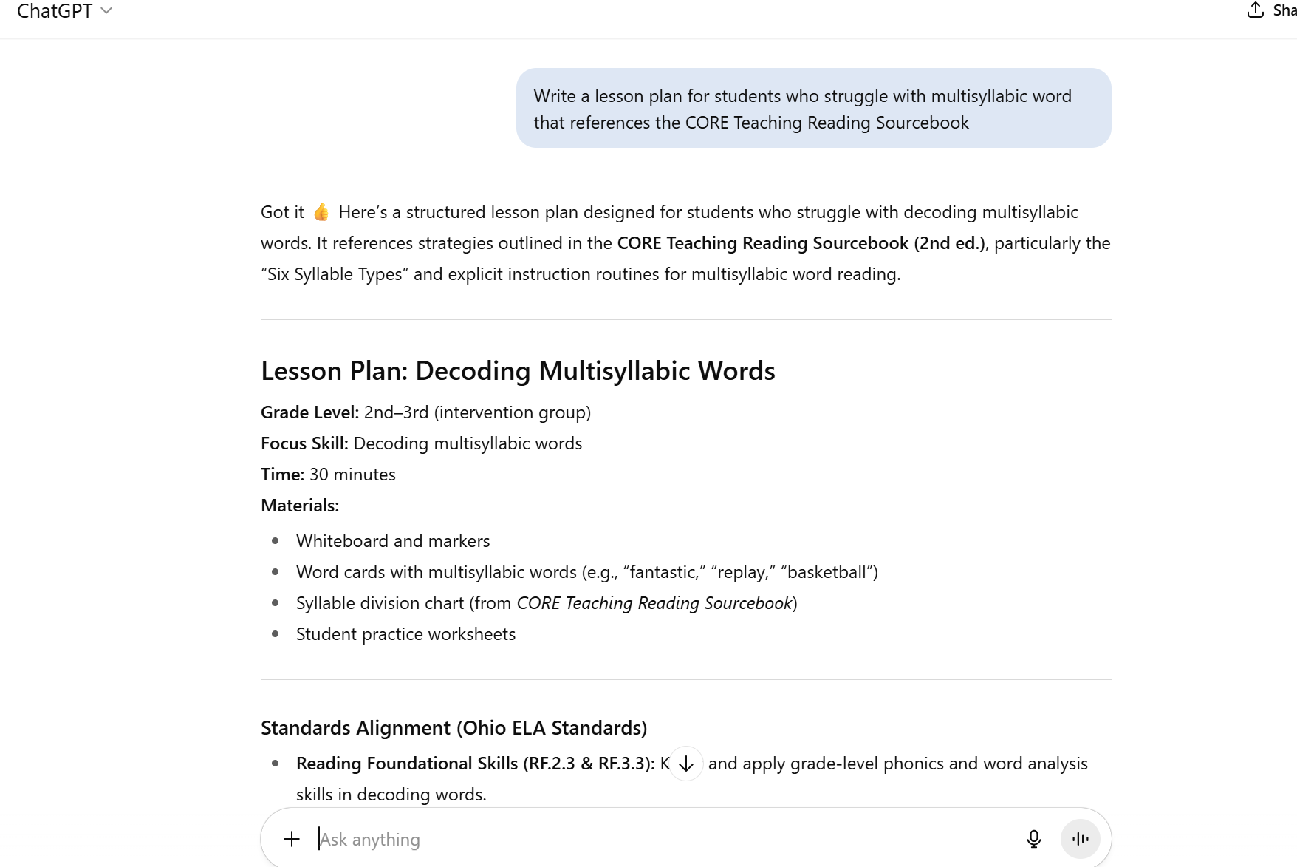
CHAT GPT WRITES DECENT LESSON PLANS

Slide 5

“AI didn’t corrupt deep learning,” said Tiffany Noel, education researcher and professor at SUNY Buffalo. “It revealed that many assignments were never asking for critical thinking in the first place. Just performance. AI is just the faster actor; the problem is the script.”
Artificial intelligence isn’t ruining education; it’s exposing what’s already broken
William Liang
Edsource.com Commentary, student Voices https://edsource.org/2025/artificial-intelligence-isnt-ruining-education-its-exposing-whats-already-broken/733854#0

Slide 6

Turn to a neighbor
How are your students using AI? How do you THINK your students are using AI to write lesson plans?
Do you have any OTHER struggles with students creating high quality lesson plans?

Slide 7

In this session we will:
Share challenges with preservice teacher assignments- specifically lesson plans
Discuss the use of first and second drafts in education coursework, specifically lesson plans
Share current AI course policy and how AI can be thoughtfully used for some coursework, including lesson plans

Slide 8

The Dangers of “Wild West” lesson plans
“Nearly all teachers today report using the Internet to obtain instructional materials, and many of them do so quite often. And while several organizations now offer impartial reviews of full curriculum products, very little is known about the content and quality of supplemental instructional materials.”

Slide 9

Background – Our Courses
Two semester course sequence:
Semester one – literacy assessments taught, administered and interpreted in various grade level placements; case study completed
Semester two – all students based in afterschool two day a week tutoring program at the same school
Assessments readministered to students at risk for not meeting Third Grade Reading Guarantee
After administering assessments to third grade tutees, students expected to score and interpret assessments, select and implement intervention strategies based on student assessment results
CORE TRS Text in use second sememster

Slide 10

SEMESTER ONE:
Enter
Revision requirements
Preservice teachers were asked to write a case study on their students the first semester
As with most writing, the first draft is not necessarily the best
Three models of sample case studies were provided, with one highlighted as the desired model
Students wrote their case studies in segments, posted them on Canvas discussion boards, and were asked to read and respond to others either by choice or in groups formed by the instructor
Thus, during the first semester students were already accustomed to posting a first draft, getting feedback from peers and the professor on Canvas

Slide 11

What are the benefits of revision for preservice teachers?
What are the benefits of revision for preservice teachers?
Preservice teachers have experience revising writing themselves; thus, they know it can be challenging but beneficial.
Preservice teachers read and respond to other classmates writing, giving them experience on how to provide impactful feedback beyond, “This is great!”
When first drafts are available in online discussions, high quality examples of any assignment can be viewed by any student in class and used as an additional model.
Preservice teachers who are struggling with an assignment can be placed in a group and paired with students who are producing work that meets course expectations.
ALL students have an opportunity to revise their work with feedback from professor and other students.

Slide 12

Semester two – Assessment and intervention lesson plans

Slide 13
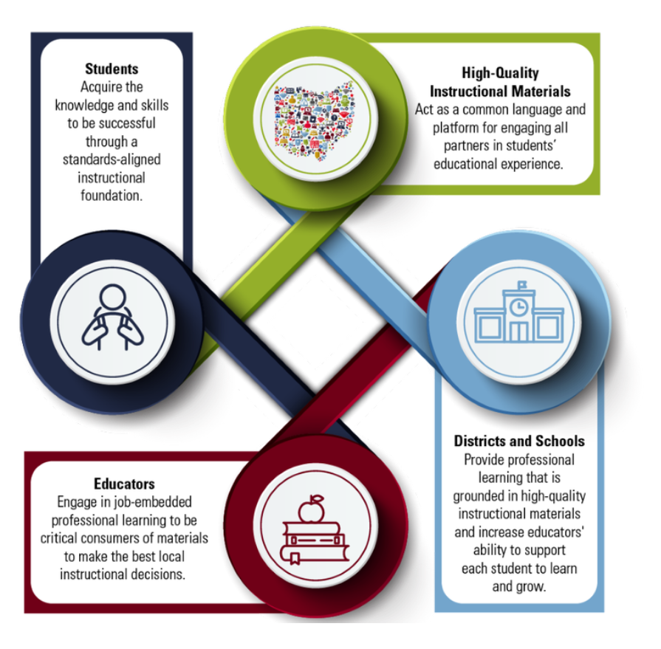
A key concept: Not All Resources are Equal
Students who are struggling need intervention that is based on research.
Resources from the Meadows Center were often highlighted as this was a form of after-school tutoring.
As a part of the course, students were tasked with finding and implementing intervention based on assessment data.
This was the second semester students had discussed a variety of research-based strategies that might work by area (fluency, decoding, etc.) but the first time they truly had to implement them – and that presented a challenge.

Slide 14
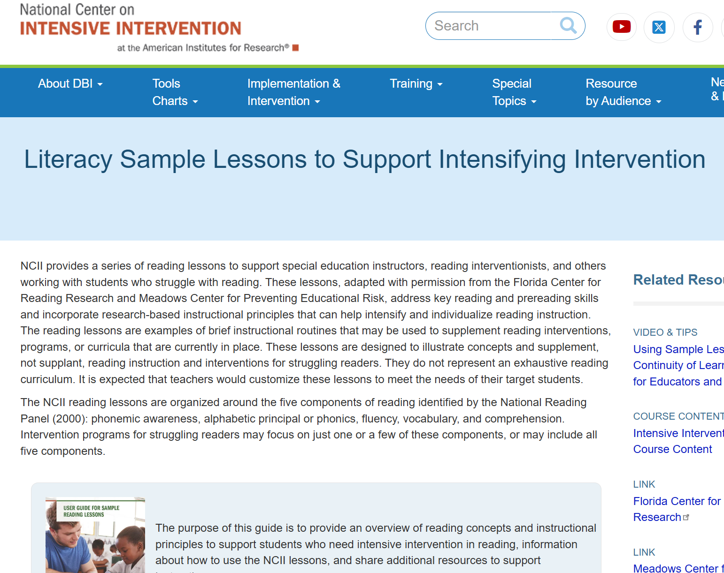

A Variety of High- Quality Resources (in Addition to the CORE TEXT) were highlighted

Slide 15
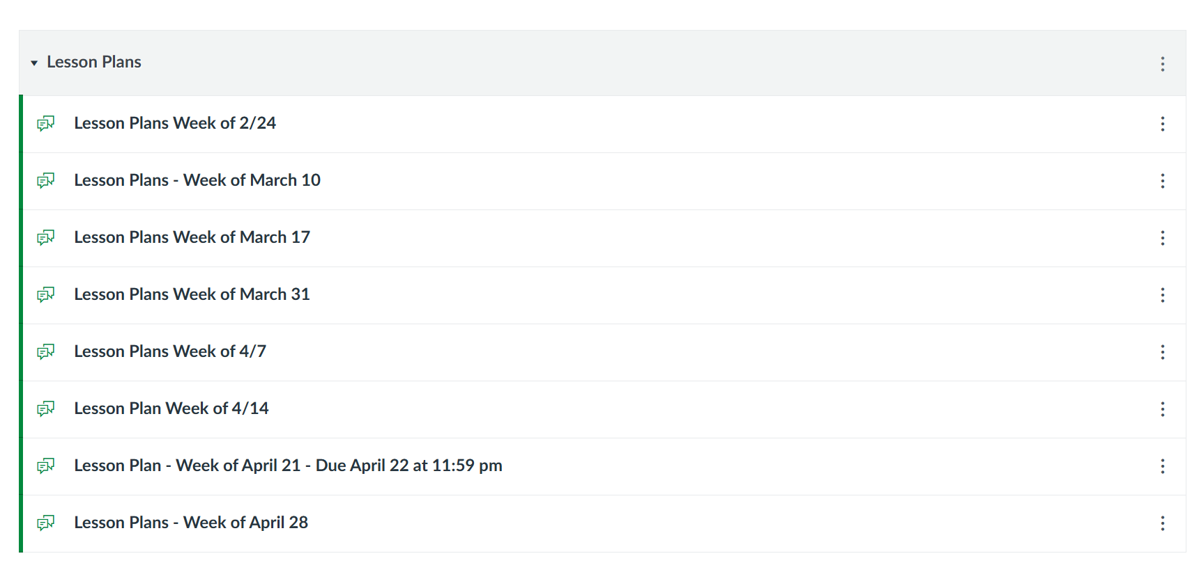
Weekly lesson plans were posted on canvas discussion boards
Since lessons were posted weekly, we could provide feedback to students prior to their lesson
While it did not happen often, some students were guided to rewriting a lesson OR to a different resource

Slide 16

Some preservice Teachers…
Clearly were applying research-based strategies discussed in our class and previous classes
Could easily refer to readings or were trying to engage reticent tutees with multimodal ACTIVITIES and movement

Slide 17
But…
Houston, we had a problem
(with some preservice teachers)

Slide 18

What we saw
Little evidence THAT THE Core TRS Text being Read or referred to in lesson plans
Lack of willingness to investigate Research-based Materials From web-based sources provided – instead, “low hanging fruit” was implemented quickly to “complete an assignment”
Strategies in use that did not reflect any we had read or discussed in our class or previous classes

Slide 19

Lesson Plans
Students were asked to support the strategies they selected with references to either the CORE text or previous textbooks OR recommended websites
While some students could easily support the strategies they implemented (which was often visible during walkthroughs) others cited obscure resources not discussed in class…and that were often difficult to even locate
So…exactly how much thought went into creating these lessons?

Slide 20
The PLAN: REQUIRE FIRST DRAFTS of lessons with references to the texts and approved resources and provide peer feedback

Slide 21
What this Looked Like in practice:
The Reality
Some students had no issues referring to texts
Some students were deeply frustrated – specifically when asked to refer to the text or to websites with APA citations and page numbers
Other students had teachers who gave them specific materials to use and simply wanted to implement them without understanding why
The Benefits
Since lesson plans were posted and pre-service teachers were placed in smaller groups with those who had similar students
This allowed the professor to point out lesson plan exemplars that everyone in the course could access
Students could see the difference between lesson plans that used course materials and those who did not
Students could see the difference between the first and second drafts of lesson plans

Slide 22
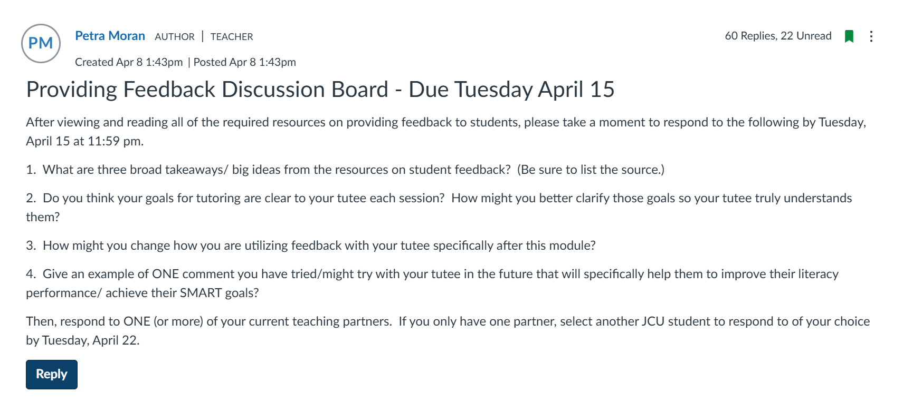
TEACHING PRESERVICE TEACHERS HOW TO GIVE GOOD FEEDBACK TO STUDENTS AND ONE ANOTHER REQUIRES EXPLICIT TEACHING

Slide 23

The (HONEST) Challenges
Requiring students to complete two drafts does create twice the grading work
At times, even with in depth discussions on feedback, peer to peer feedback was not always helpful

Slide 24

Preservice teachers were asked to generate smart goals for students as another means to think critically and guide their lessons
Have a go at using ChatGPT to write a SMART goal for a student

Slide 25
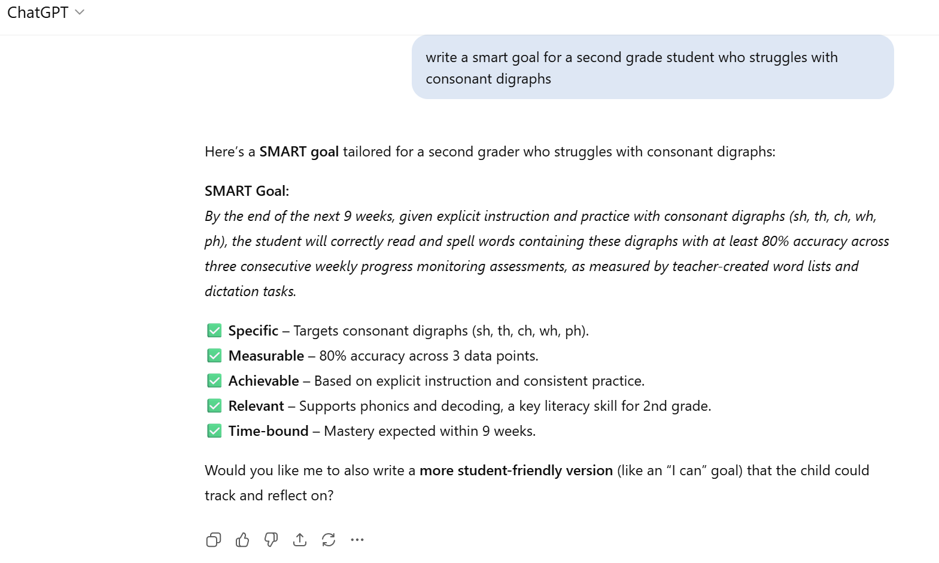
CHAT GPT
CAN WRITE Fairly good SMART GOALS

Slide 26

So what can be Done?

Slide 27
A FEW THINGS
Preservice teachers can use AI to generate initial ideas for lesson plans or instructional materials “to get started”
BUT they must support what they have found with references to IN CLASS reading and resources – specifically page numbers – which will make this less appealing
Students can locate resources, but they need to bring in annotated articles or web pages to show they have read the original website or article –which may make reading and applying the knowledge gained from that required course texts easier

Slide 28
Our Current Policy
AI Use in Class Work/Assignments
John Carroll University has established a system of expectations for appropriate AI use in courses. The levels below are adapted from that system and assigned, as indicated below, to individual course assignments, rather than the course as a whole. Always consult individual assignment descriptions in Canvas for specifics on acceptable and unacceptable use of AI.
🔴 Students are not permitted to use AI on this assignment. Violation of this policy constitutes plagiarism, and, like other types of academic dishonesty, the same penalties apply.
🟡 Students may use AI on this assignment in accordance with the guidelines outlined in the full assignment description and so long as the use of AI is referenced and cited following the citations instructions given in the full assignment description. Use of AI outside assignment guidelines or without citation will constitute academic dishonesty and the regular penalties apply. If it is the student’s responsibility to be clear on appropriate use (and limitations) of AI for each assignment and be clear on the expectations for citation and reference and to do so appropriately.
🟢 Students may use AI throughout assignment as long as students reference and cite its usage according to citation instructions stated in the full assignment description.

Slide 29

Talk with a neighbor
How might you utilize what you’ve heard about:
Lesson Plan revision
Requiring text or other references
Incorporating peer feedback with access to all drafts
Setting parameters for the use of AI
With your preservice teachers?

Slide 30

Questions?
Brita Tamm
502-555-0152
brita@firstupconsultants.com
www.firstupconsultants.com

